Slide 1
Protein Pow(d)er
Programmeertheorie, Week 2, Presenteersessie 2
Team: Shire Peasants 3
Authors: Mark Dzoljic, Loek van Steijn, Sebastiaan Kruize

Slide 2
Format of the presentation
1. Introduction in the casus
State Space of the problem
2. Quick recap of last weeks datastructures
3. Algorithms
Random, Greedy and more
4. Results and Conclusion
5. Q&A and discussion

Slide 3
1. Introduction: Stability of proteins
Proteins fulfill numerous function inside the human body
Consist of a ’string’ of amino-acids
Faulty proteins linked to diseases such as Alzheimers or huntington
Finding “Stable” Proteins can help in the development of farmaceuticals

Slide 4
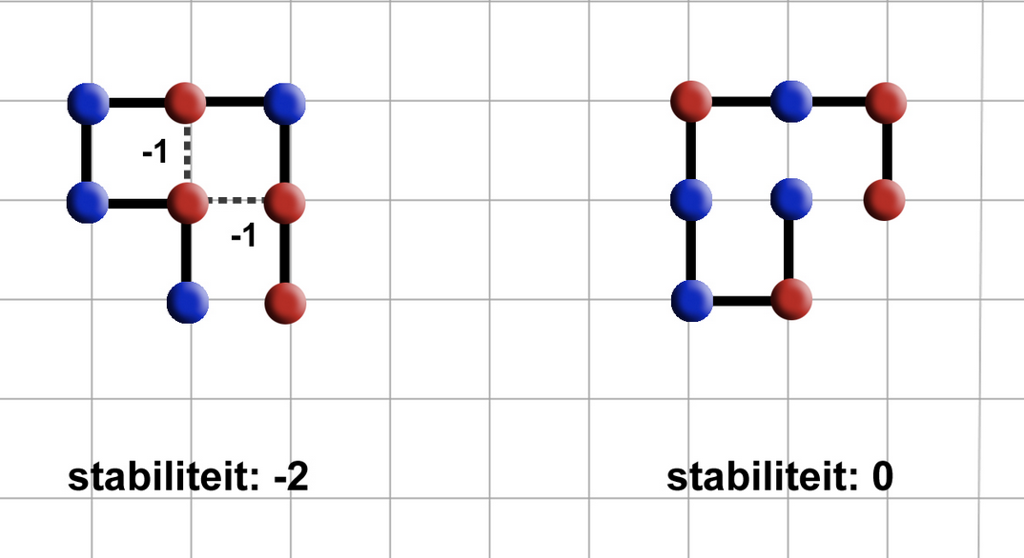
1. Introduction: Stability of proteins
Place amino-acids on a 2D-grid.
Amino acids can be hydrophic (Red) or Polair (Blue)
Red amino-acids can form bridges, and strengthen the stability
Goal is to find protein structures that are as stable as possible.

Slide 5
1. Case exploration
Constrained Optimization Problem
Constraints
Amino-acid string is given
All amino-acids must be used
Can not move ‘diagonally’ must move either left/right/up/down
Amino-acids cannot overlap
Optimization
Legitimate solution with the highest stability
State Space (2D)
4^{n}?
4*3^{n-1}
Pruning
Rotating proteins are the same
Upper bound: < 3^{n-2}

Slide 6
3. Algorithms
Tried:
Self avoiding random walk (SARW)
SARW with a twist
Greedy
Extended Heuristic Algorithm
Breadth-first: Beam Search
Next up:
Hill Climber (pull moves)

Slide 7
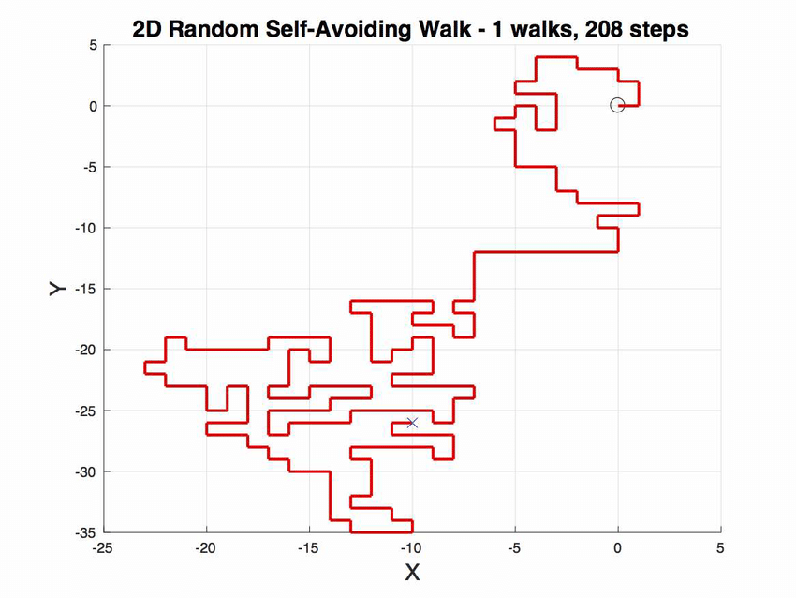
Self avoiding random walk
Let S be HP-chain of length n.
Fix first 2 elements of chain.
For subsequent elements up to the n^{th} element, choose random move from {u, d, l, r, i, o}.
If newly chosen coordinates are occupied, try new move.
Stuck? Start over.

Slide 8
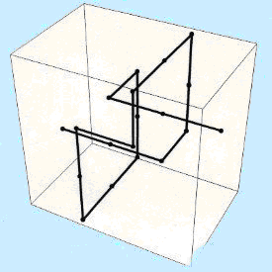
Self avoiding random walk (with a twist)
Let S be HP-chain of length n.
Fix first 2 elements of chain.
For subsequent elements up to the n^{th} element, choose random move from {u, d, l, r, i, o}.
If newly chosen coordinates are occupied, try new move.
If newly chosen coordinates are on the border, try new move.
Stuck? Start over.

Slide 9
Greedy
Let S be HP-chain of length n.
Fix first 2 elements of chain.
For subsequent elements, try all moves from {u, d, l, r, i, o} and check whether move would result in H-H connection (with self-avoidance).
If so, use the move. If not, pick random.
Stuck? Start over.

Slide 10
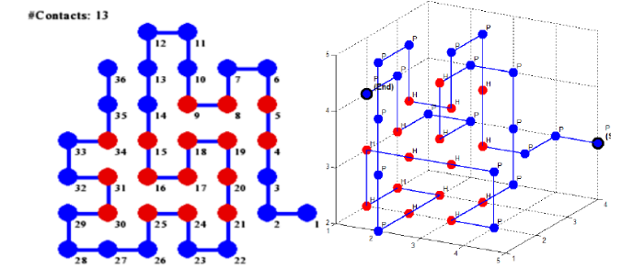
Extended Heuristic Algorithm
Divide chain S up into n parts S_{i} of predetermined length.
Fold S₁ optimally against S₀ by going through all permutations (with self-avoidance), then fold S₂ optimally against S₀ ∪ S₁, etc. up until S_{n}.
Optimal means most H-H contacts.
Source: Traykov, Metodi, et al. "Algorithm for protein folding problem in 3D lattice HP model." International Journal of Biology and Biomedicine 3 (2018).

Slide 11
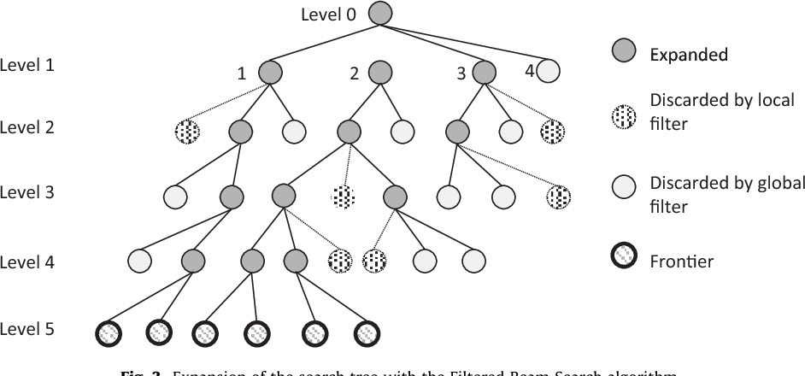
Breadth-first: Beam Search
Combination of breadth-first and greedy.
Goes through all moves from {u, d, l, r, i, o} and selects the n best moves (based on ‘beam width’).
From selected n moves, go 1 level deeper and repeat up until maximum depth.

Slide 12
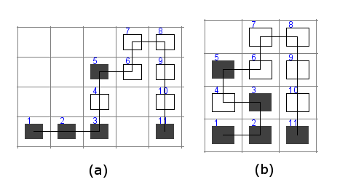
Hill Climber (Pull moves)
Iterative algorithm.
Starts with a solution.
Goes through the solution and tries to pull an elements diagonally to increase stability.
Better stability -> new solution.
Worse stability -> old solution.
Repeat until stability converges.
Source: Chira, Camelia. "Hill-climbing search in evolutionary models for protein folding simulations." Stud Univ Babe\c s-Bolyai Inform 55 (2010): 29-40.

Slide 13
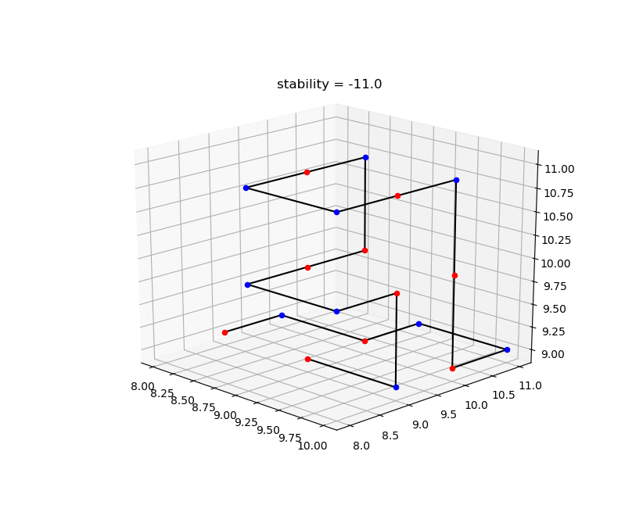
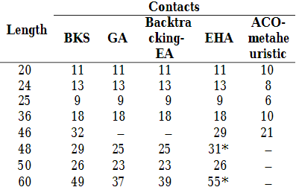
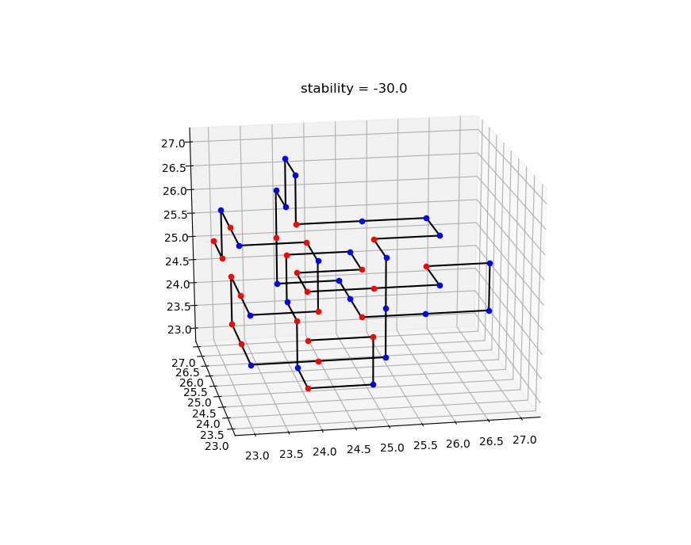
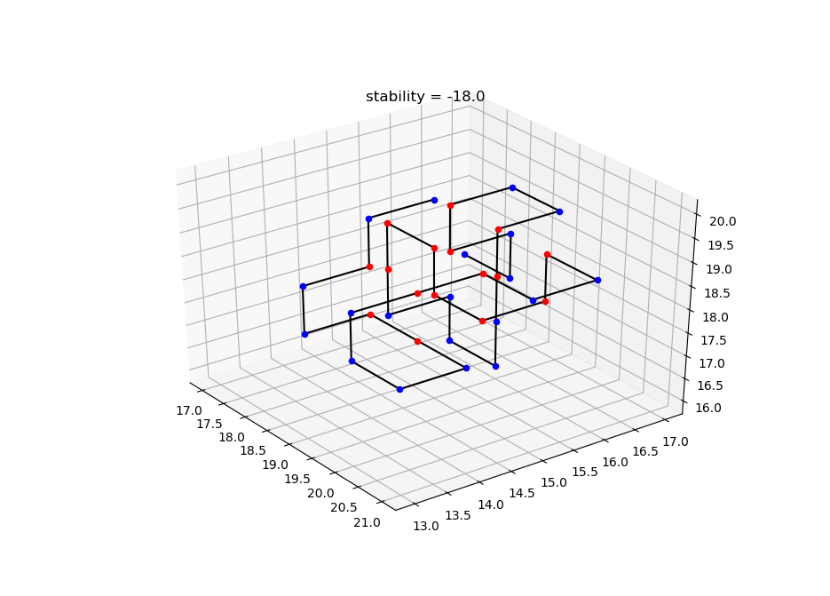
BENCHMARKS + RESULTS EHA+

Slide 14
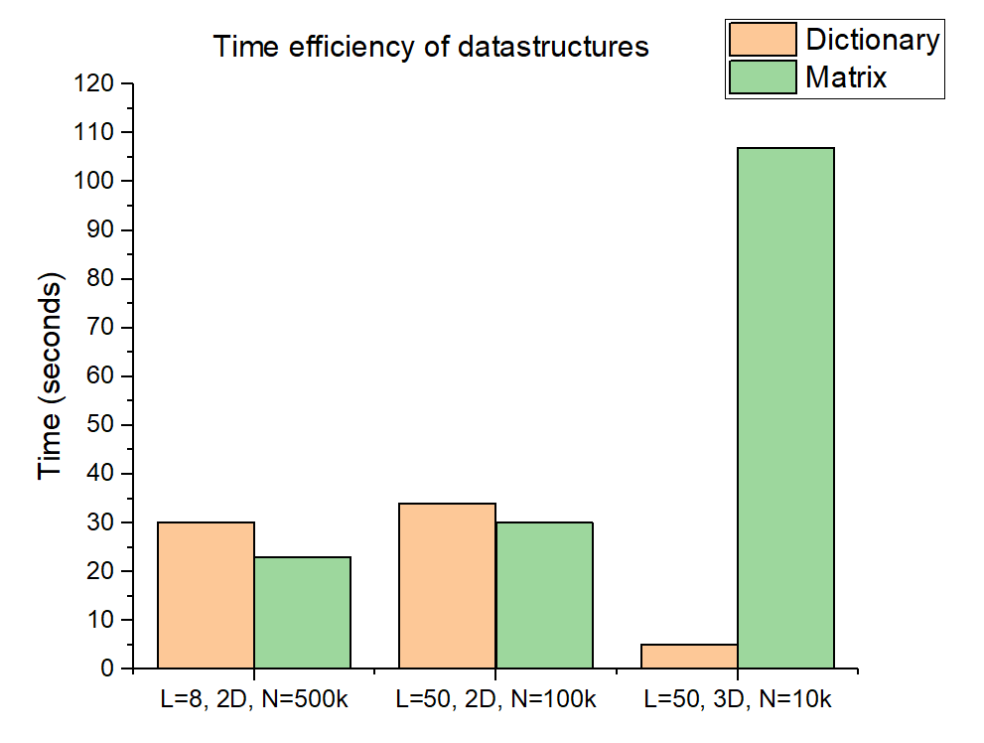
Results – Data structure
L: length of protein
N: number of iterations

Slide 15
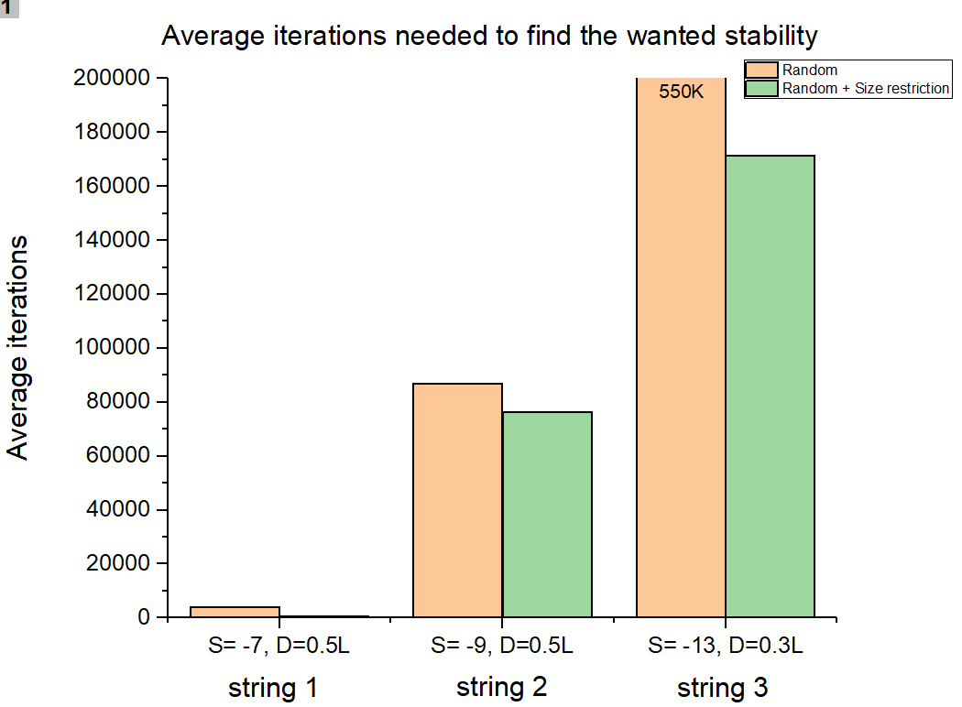
Results – Size restricted configuration
S: wanted stability
D: dimension of matrix
L: length of protein
String 1 (L=14): HHPHHHPHPHHHPH
String 2 (L=20): HPHPPHHPHPPHPHHPPHPH
String 3 (L=36): PPPHHPPHHPPPPPHHHHHHHPPHHPPPPHHPPHPP

Slide 16
Conclusions
Data structures
Size restriction
Situation | Matrix (time) | Dictionary (time) | Improvement
L=8, 2D, N=5E⁵ | 23 s | 30 s | +23%
L=50, 2D, N=1E⁵ | 30 s | 34 s | +12%
L=50, 3D, N=1E⁴ | 107 s | 5 s | -2040%
Size restriction D=0.5L | 3 s | 5 s | +40%
Situation | Random iterations | Size restricted iterations | Improvement
S=-7, L=14, D=0.5L | 4076 | 555 | +86%
S=-9, L=20, D=0.5L | 86881 | 76272 | +12%
S=-13, L=36, D=0.3L | 530253 | 171503 | +67%

Slide 17
Questions and comments?
Thank you for your attention

